Slide 1
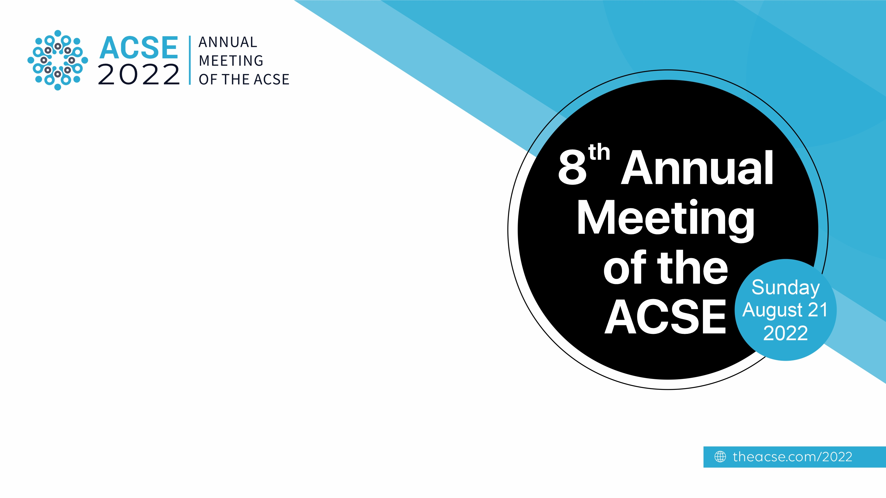

A Tsunami of Retracted Papers during the COVID-19 Pandemic
Reza Gharebaghi MD, MPH, PhDc, FAAO
IVORC

Slide 2

Conflict of Interest
http://rezagharebaghi.top/
Figures from: https://unsplash.com/

Slide 3
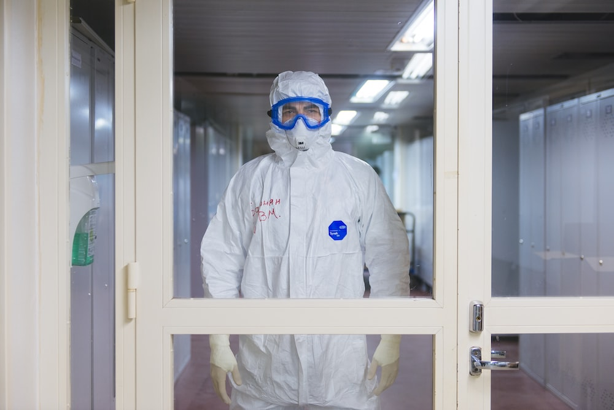
Introduction
The COVID-19 pandemic has caused immense hardship and human tragedy over the past years, affecting all aspects of life.
The human community that boasted of modern diagnostic and treatment technologies continues to remain in a state of shock.
Source: Heidary F, Gharebaghi R , COVID-19 impact on research and publication ethics. Med Hypothesis Discov Innov Ophthalmol. 2021 Spring; 10(1): 1-4. https://doi.org/10.51329/mehdiophthal1414

Slide 4
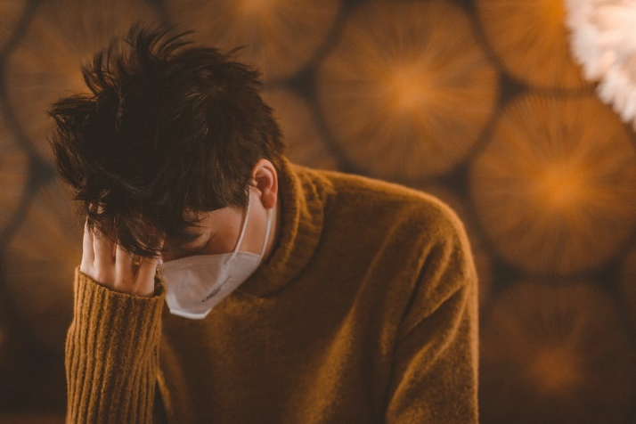
The pandemic has once again proved that science still has a long way to go. Given the challenges that COVID-19 has brought with, it is imperative for different disciplines of the research community to study this.
Social and Academic Responsibility Given COVID-19 Pandemic!
Source: GHAREBAGHI R, HEIDARY F. Social and Academic Responsibility Given COVID-19 Pandemic. IJPH. 2020;49 (Supple 1):134-135.

Slide 5
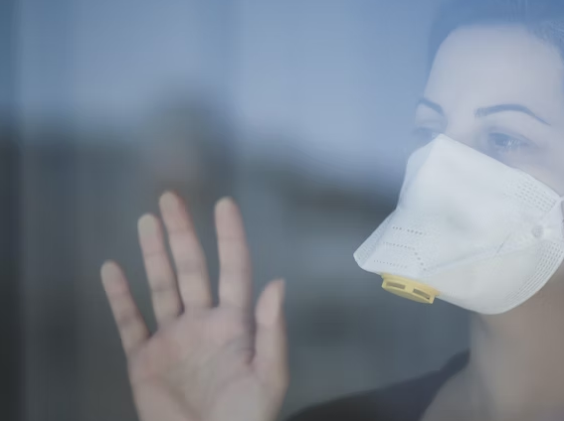
Acceleration or Precision
The lockdown imposed following its outbreak made an increase in the number of papers submitted by researchers.
Several journals have shown haste both in peer review and acceptance of COVID-19-related papers.
Submissions to journals showed an irregular and exponential growth.
The irregularities happed! In the first wave of the pandemic, compared to other time periods, there were fewer research articles by female authors compared to their male colleagues, which could be attributed to the additional responsibilities that women shoulder at home

Slide 6
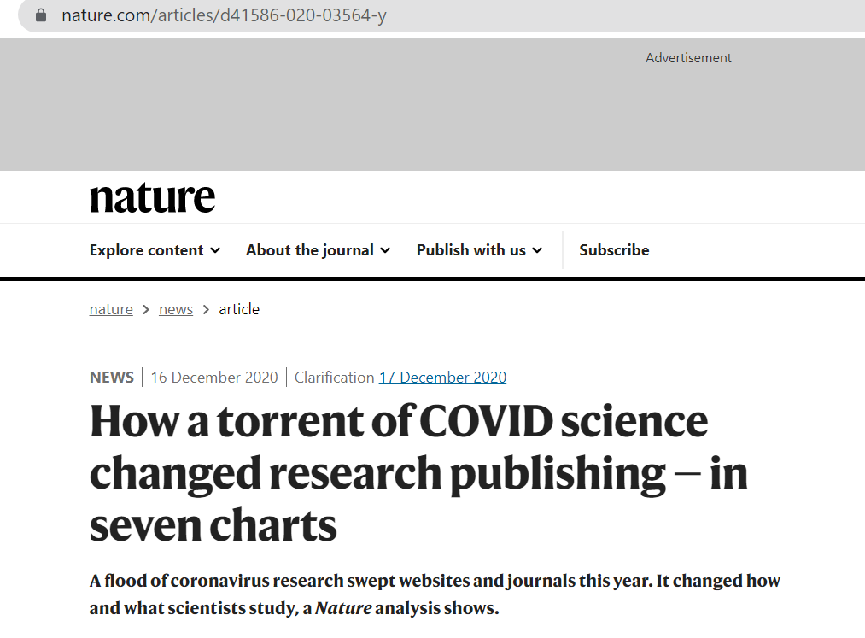
Professor Flaminio Squazzoni
“The pandemic has given incredible opportunities for researchers but it has also been a shock to the academic system, with an explosion of publications and citations for COVID-19 papers.”

Slide 7
Retractions
The large number of submissions on the one hand and journals’ preference to publish more papers on COVID-19 on the other, made the ethical process of peer reviewing challenging, with many papers being retracted in a short timeframe.

Slide 8

Committee on Publication Ethics (COPE) guideline defined that “Retraction is a mechanism for correcting the literature and alerting readers to publications that contain such seriously flawed or erroneous data that their findings and conclusions cannot be relied upon. Unreliable data may result from honest error or from research misconduct”
The main purpose of retractions is to correct the literature and ensure its integrity rather than to punish authors who misbehave.

Slide 9
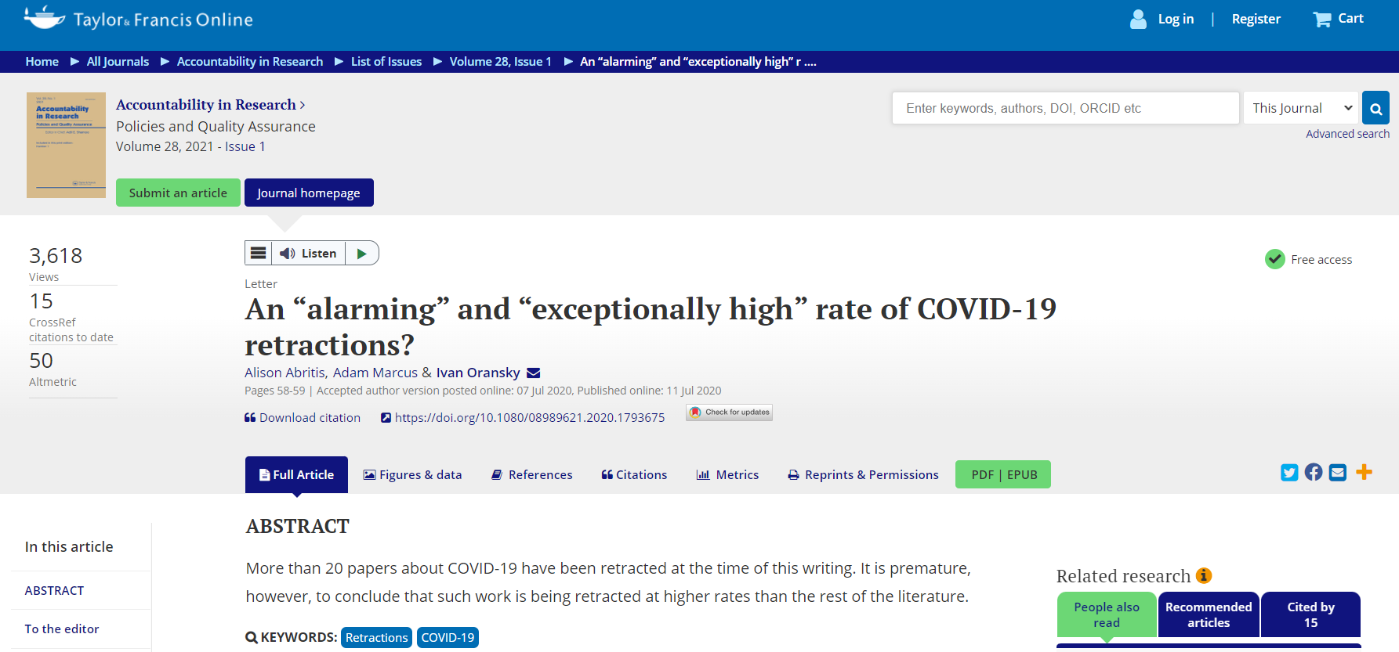

Slide 10
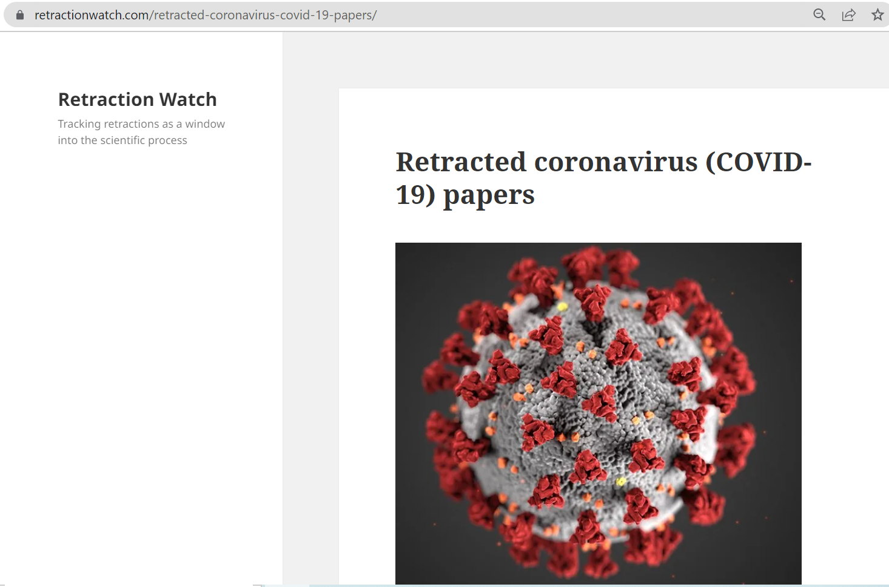
Recently, based on the Retraction Watch Database, a tool for monitoring retracted papers, 254 articles concerning COVID-19 were retracted. Furthermore 14 expressions of concern were published

Slide 11

Although studies show that retractions take around three years on average, for COVID-19 literature, this timeframe has been reduced to only a few months.
Standards of peer reviewing and publication are in a dire need of restructuring in order to reduce the incidence of retraction owing to misconduct.

Slide 12
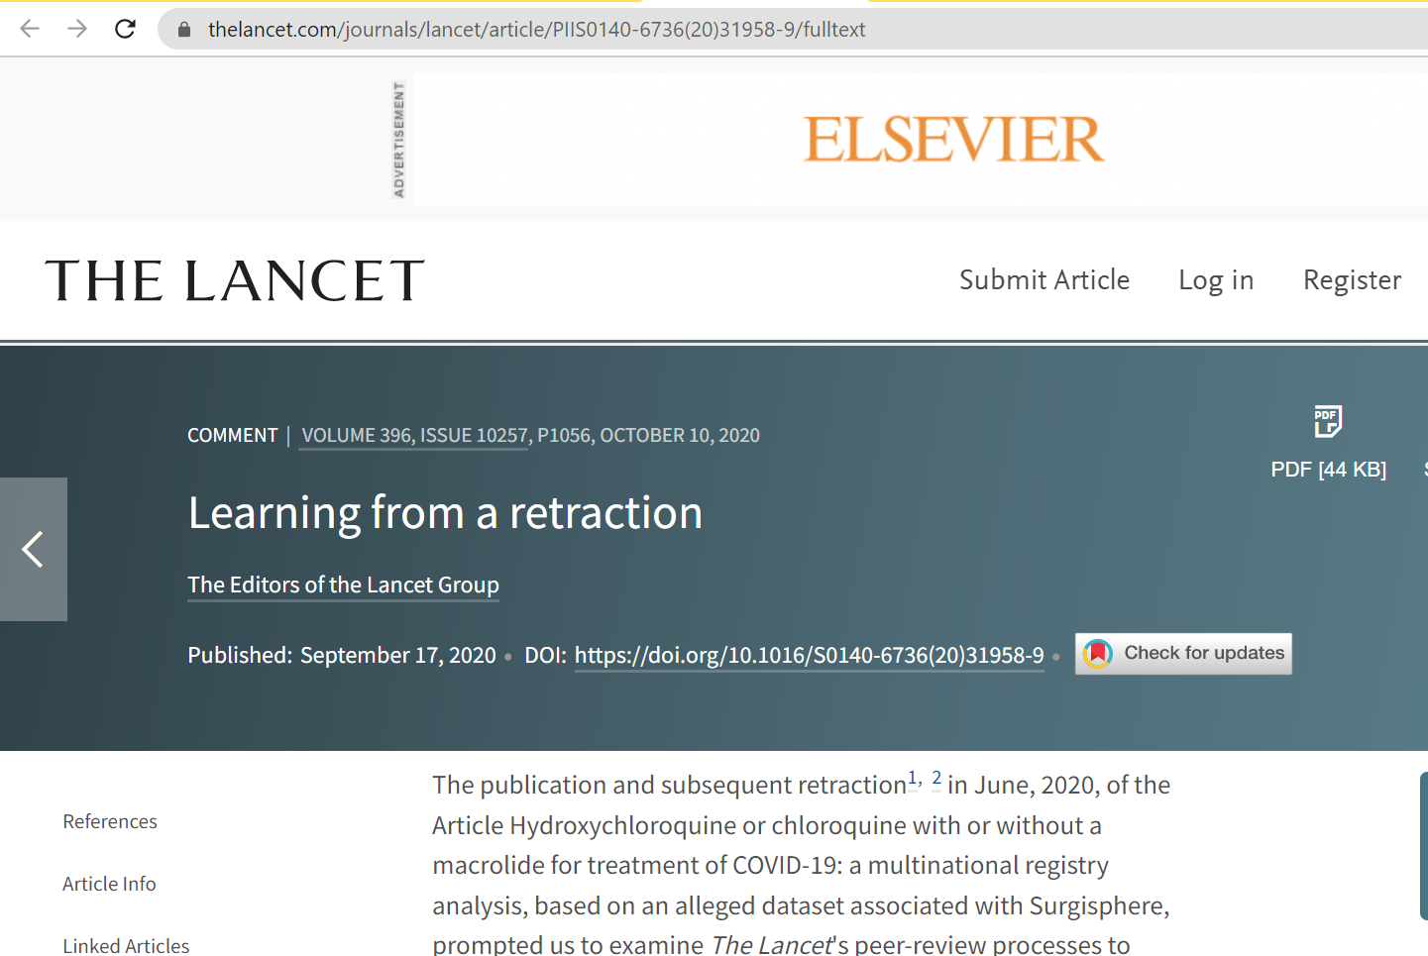
A study on the effects of hydroxychloroquine on COVID-19 was published in the Lancet, which was later retracted and led to the designing of a new independent peer review system concerning papers containing large datasets or real-world data. This even led to the use of experts in data science, besides statistical peer reviewers, with particular focus on data sharing statement.

Slide 13
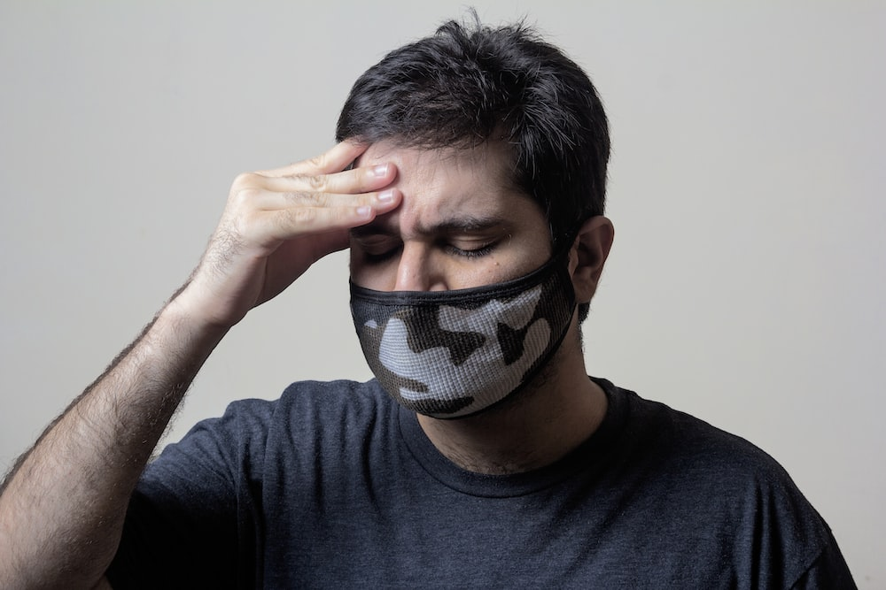
Preprints, Big Headache in Research Integrity
“A preprint is usually withdrawn only at an authors’ wishes. A preprint server will not typically withdraw a flawed preprint against the wishes of the author, since the server made no claim to have peer-reviewed and certified the scientific content in the first place”.
“At the same time, some preprint servers *will* withdraw a preprint against the authors’ wishes in instances of fraud, ethics violations, dangerous material, or legal issues”, but who is responsible for preprint content!
Source: https://retractionwatch.com/retracted-coronavirus-covid-19-papers/

Slide 14

Suggestion
FES (Field expert, Ethics expert, and Statistical peer reviewer).
One is a field expert peer reviewer who reviews the subject in his/her specialty field.
A reviewer review the subject in terms of compatibility with the principles of ethics.
An expert checks the details of the datasets and statistical integrity of the research article.
Journals should proportionally hire more expert peer reviewers especially paid peer reviewers.
Source: Heidary F, Gharebaghi R , COVID-19 impact on research and publication ethics. Med Hypothesis Discov Innov Ophthalmol. 2021 Spring; 10(1): 1-4. https://doi.org/10.51329/mehdiophthal1414

Slide 15

Email:
drgharebaghi@yahoo.com

